Slide 1
Riser And Mooring Feasibility Analysis Report
Structural schema of report by using Python
Work Flow Learnings
10th March 2017

Slide 2
About python
Python is a general-purpose interpreted, interactive, object-oriented, and high-level programming language. Python software is available as free open source and it was located in the following link address
https://www.python.org/
Download the software from the link and install in computer
For installing process we need to follow the rules as shown in video and link as follows
https://www.youtube.com/watch?v=bHyiXDJVjY8&list=LLTp1xL79LxITA2osvjFLsJA&index=1

Slide 3
About wamp
Wamp Server refers to a software stack for the Microsoft Windows operating system, consisting of the Apache web server the word wamp refers to windows, apache, MySQL, php or python.
We need to download the wamp software from the following link
https://sourceforge.net/projects/wampserver/files/WampServer%202/Wampserver%202.4/
After downloading the wamp software we need to install it in computer
For that process we followed same link video
https://www.youtube.com/watch?v=bHyiXDJVjY8&list=LLTp1xL79LxITA2osvjFLsJA&index=1

Slide 4
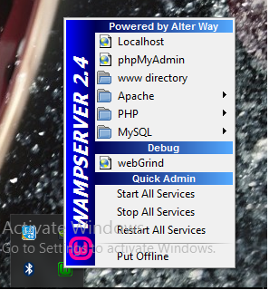
Wamp Instructions
After installing the wamp software from the link address a folder path was located in selected drive (C drive) with the name of wamp.
We need to start the wamp server on every time when pc starts.
We can check the wamp server is in online or offline by clicking
show icons shortcut in the desktop menu bar.

Slide 5
Wamp Instructions
Python script codes all are need to be saved in the following location
“C:\wamp\www\”
We need to call the location on browser url with localhost/programname.py
then click enter to go, program output can be viewed on browser.

Slide 6
Internal Workflow Structure
Flow Diagram:
Text File Data (Notepad)
Python Script (IDLE)
Data from Text file appended/Updated to HTML File
Executes Python Program Which runs HTML File (WAMP Server)
Python Output viewed in Browser

Slide 7
Internal Workflow Structure
Description:
Text File:
Data for the Report in saved in a text file.
Python Script:
Through Python code the data in the text file is retrieved.
Updating HTML:
The retrieved text file data is appended or updated in the HTML file which is linked in Python code.
Execute code:
The code is executed through python in browser and also can executed in server using WAMP Server.
Report output is viewed in the browser.

Slide 8
Structural schema of report by python
Flow Diagram:
TEXT FILE DATA
IMAGES Folder
CONVERTER
Framework / Plugin/Program
HTML code
CSV Charts Folder
This can be invoked manually once by engineer
(or) Every time by the end user when he clicks on the report.
Final Report on Browsers

Slide 9
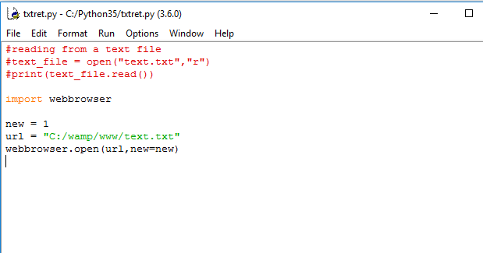
Work Status
We have successfully retrieved the text file data in Python IDLE window, but we can’t retrieving the same text file data in browser.
When have tried to open text file through Python code using WAMP Server we are getting a 500 Internal Server Error.
We obtained output in Python IDLE by using below code,

Slide 10
Way Forward
We need to show the data from text file in the browser using WAMP server.
We need to apply styles to the retrieved text file data.

Slide 11
THANK YOU
For the opportunity to serve!

Slide 12
Document Revision History
01 | New Document | 10st March 2017 |  | VK
Rev | Description | Date |  | Author | Checked | Approved
Document No: |  |  | Client Ref:

